Slide 1
CNN in class

Slide 2
Recall:Key points about Convolution layers and Filters
The depth of a filter in a CNN must match the depth of the input image. The number of color channels in the filter must remain the same as the input image.
Different Conv2D filters are created for each of the three channels for a color image.
Filters for each layer are randomly initialized based on either Normal or Gaussian distribution.
Initial layers of a convolutional network extract high-level features from the image, so use fewer filters. As we build further deeper layers, we increase the number of filters to twice or thrice the size of the filter of the previous layer.
Filters of the deeper layers learn more features but are computationally very intensive.

Slide 3
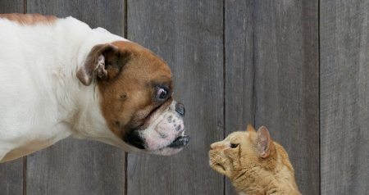

Slide 4
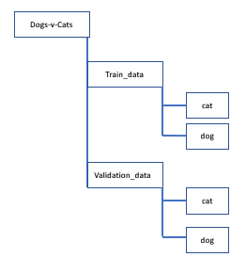
Create data sets
Download data https://www.kaggle.com/c/dogs-vs-cats/data
Unzip the file and create the folders
Split the data into the training dataset with 10,000 cats and 10,000 dogs images and validation dataset containing 2500 cats and 2500 dogs images

Slide 5
Set key parameters
batch_size = 64 epochs = 50 IMG_HEIGHT = 150 IMG_WIDTH = 150

Slide 6
Rescale and Apply different Augmentation to the training image
train_image_generator = ImageDataGenerator( rescale=1./255, rotation_range=45, width_shift_range=.15, height_shift_range=.15, horizontal_flip=True, zoom_range=0.3)

Slide 7
Rescale Validation data
validation_image_generator = ImageDataGenerator(rescale=1./255)

Slide 8

Generate batches of normalized data for train and validation data set
train_data_gen = train_image_generator.flow_from_directory(batch_size=batch_size, directory=TRAIN_PATH, shuffle=True, target_size=(IMG_HEIGHT, IMG_WIDTH), class_mode='binary')
val_data_gen = validation_image_generator.flow_from_directory(batch_size=batch_size, directory=VAL_PATH, target_size=(IMG_HEIGHT, IMG_WIDTH), class_mode='binary')

Slide 9
Create the Deep Convolutional Neural network model

Slide 10
#Build the model
model = Sequential([
Conv2D(16, 3, padding='same', activation='relu',
input_shape=(IMG_HEIGHT, IMG_WIDTH ,3)),
MaxPooling2D(),
Dropout(0.2),
Conv2D(32, 3, padding='same', activation='relu'),
MaxPooling2D(),
Conv2D(64, 3, padding='same', activation='relu'),
MaxPooling2D(),
Dropout(0.2),
Flatten(),
Dense(512, activation='relu'),
Dense(1)
])

Slide 11
# Compile the model
model.compile(optimizer='adam', loss=tf.keras.losses.BinaryCrossentropy(from_logits=True), metrics=['accuracy'])

Slide 12
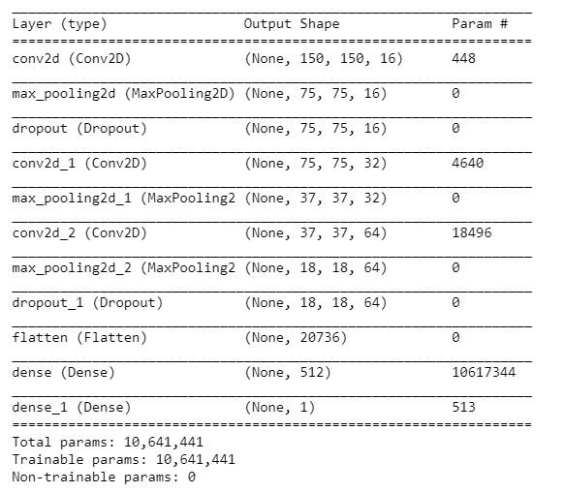
# print the model architecture
model.summary()

Slide 13
Training the Model
history = model.fit_generator( train_data_gen, steps_per_epoch=1000, epochs=epochs, validation_data=val_data_gen, validation_steps=1000 )

Slide 14
Feature Visualization
Feature Visualization translates the internal features present in an image into visually perceptible or recognizable image patterns. Feature visualization will help us understand the learned features explicitly.

Slide 15
Visualizing Filters or Feature Detectors in a CNN
Iterate through all the layers of the model using model.layers
If the layer is a convolutional layer, then extract the weights and bias values using get_weights() for that layer.
Normalize the weights for the filters between 0 and 1
Plot the filters for each of the convolutional layers and all the channels. For Color image, you will have three channels for RGB. For a grayscale image, the number of channels will be 1
CNN uses learned filters to convolve the feature maps from the previous layer.
Filters are two- dimensional weights and these weights have a spatial relationship with each other.

Slide 16
#Iterate thru all the layers of the model for layer in model.layers: if 'conv' in layer.name: weights, bias= layer.get_weights() print(layer.name, filters.shape) #normalize filter values between 0 and 1
# for visualization f_min, f_max = weights.min(), weights.max() filters = (weights - f_min) / (f_max - f_min) print(filters.shape[3]) filter_cnt=1
#plotting all the filters for i in range(filters.shape[3]): #get the filters filt=filters[:,:,:, i] #plotting each of the channel, color image RGB channels for j in range(filters.shape[0]): ax= plt.subplot(filters.shape[3],
filters.shape[0], filter_cnt )
ax.set_xticks([]) ax.set_yticks([]) plt.imshow(filt[:,:, j]) filter_cnt+=1 plt.show()

Slide 17
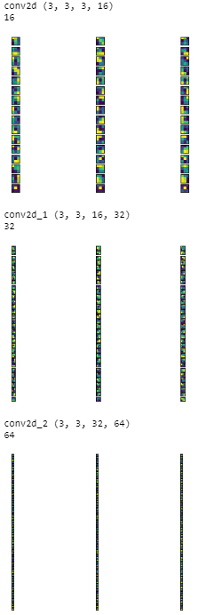
Filters applied to the CNN model for cats and dogs.

Slide 18
Visualizing Feature maps or Activation maps generated in a CNN
Define a new model, visualization_model that will take an image as the input. The output of the model will be feature maps, which are an intermediate representation for all layers after the first layer. This is based on the model we have used for training.
Load the input image for which we want to view the Feature map to understand which features were prominent to classify the image.
Convert the image to NumPy array
Normalize the array by rescaling it
Run the input image through the visualization model to obtain all intermediate representations for the input image.
Create the plot for all of the convolutional layers and the max pool layers but not for the fully connected layer. For plotting the Feature maps, retrieve the layer name for each of the layers in the model.
Feature maps are generated by applying Filters or Feature detectors to the input image or the feature map output of the prior layers.
Feature map visualization will provide insight into the internal representations for specific input for each of the Convolutional layers in the model.

Slide 19
img_path='\\dogs-vs-cats\\test1\\137.jpg' #dog
# Define a new Model, Input= image
# Output= intermediate representations for all layers in the
# previous model after the first.
successive_outputs = [layer.output for layer in model.layers[1:]]
#visualization_model = Model(img_input, successive_outputs)
visualization_model = tf.keras.models.Model(inputs = model.input, outputs = successive_outputs)
#Load the input image
img = load_img(img_path, target_size=(150, 150))
# Convert ht image to Array of dimension (150,150,3)
x = img_to_array(img)
x = x.reshape((1,) + x.shape)
# Rescale by 1/255
x /= 255.0

Slide 20
# Let's run input image through our vislauization network
# to obtain all intermediate representations for the image.
successive_feature_maps = visualization_model.predict(x)
# Retrieve are the names of the layers, so can have them as part of our plot
layer_names = [layer.name for layer in model.layers]
for layer_name, feature_map in zip(layer_names, successive_feature_maps):
print(feature_map.shape)
if len(feature_map.shape) == 4:
# Plot Feature maps for the conv / maxpool layers, not the fully-connected layers
n_features = feature_map.shape[-1] # number of features in the feature map
size = feature_map.shape[ 1] # feature map shape (1, size, size, n_features)

Slide 21
# We will tile our images in this matrix
display_grid = np.zeros((size, size * n_features))
# Postprocess the feature to be visually palatable
for i in range(n_features):
x = feature_map[0, :, :, i]
x -= x.mean()
x /= x.std ()
x *= 64
x += 128
x = np.clip(x, 0, 255).astype('uint8')
# Tile each filter into a horizontal grid
display_grid[:, i * size : (i + 1) * size] = x
# Display the grid
scale = 20. / n_features
plt.figure( figsize=(scale * n_features, scale) )
plt.title ( layer_name )
plt.grid ( False )
plt.imshow( display_grid, aspect='auto', cmap='viridis' )

Slide 22
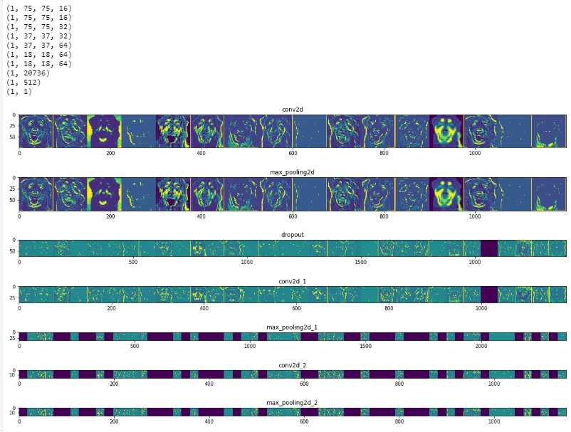
Feature map for a dog image
The snout and the tongue are very prominent features

Slide 23
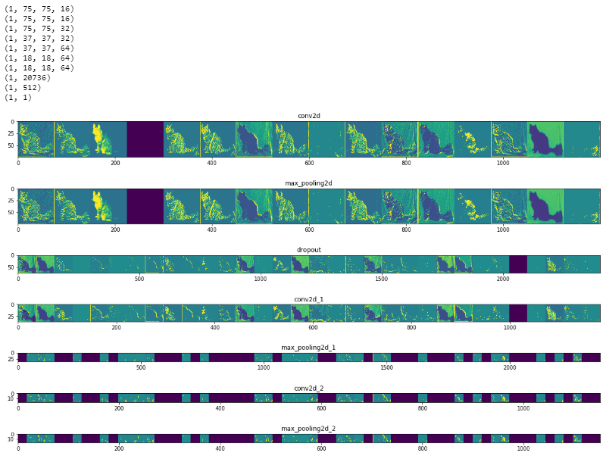
Feature map for a cat image
The ears and the tail are very prominent features

